Slide 1


Smart Outdoor
Protection System
HEAT
Team HEATGUARDS | 2026
Arsalan Lunje- 34
Heeth Patil- 42
Tanaaz Shaikh- 52
Ashish Waghmare- 67

Slide 2
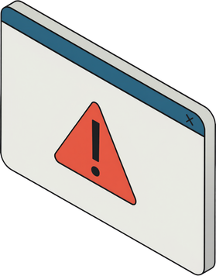
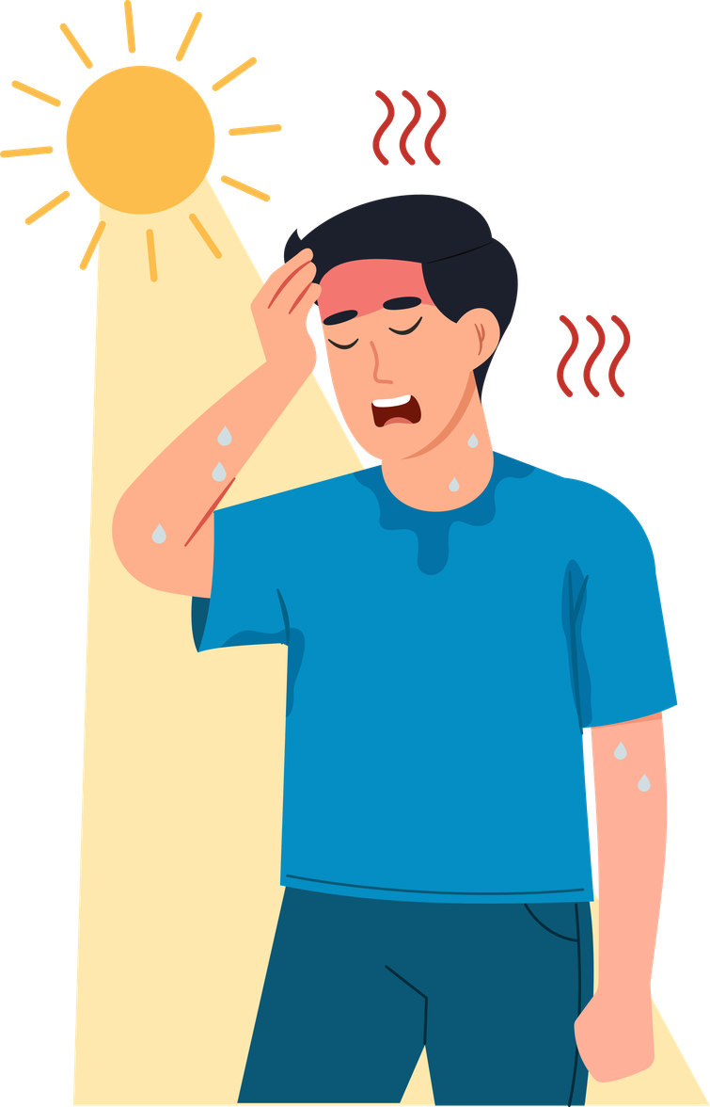
In India, more than 700 fatalities occur each year due to heat-related causes.
These deaths highlight the severe impact of rising temperatures and the urgent need for effective measures to protect vulnerable populations from extreme heat conditions.
As climate change continues to exacerbate these conditions, addressing this issue becomes even more critical to ensuring public health and safety.
To combat this, we built a real-time safety system.

Slide 3



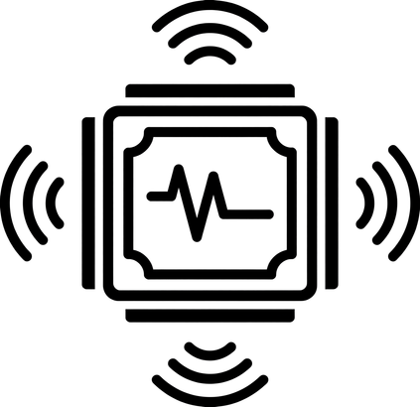

HOW IT WORKS?
01 REGISTER
02 SENSE
03 ALERT
Each worker taps their RFID card at the start of shift. The RP2040 logs them in. Monitoring activates only then.
The DHT11 sensor measures temperature and humidity every two seconds, the sensor detects sunlight, and the RP2040 computes the heat index.
If heat index crosses 39°C, buzzer fires at supervisor station. Red LED lights up. Serial monitor shows worker ID + exact danger level.

Slide 4
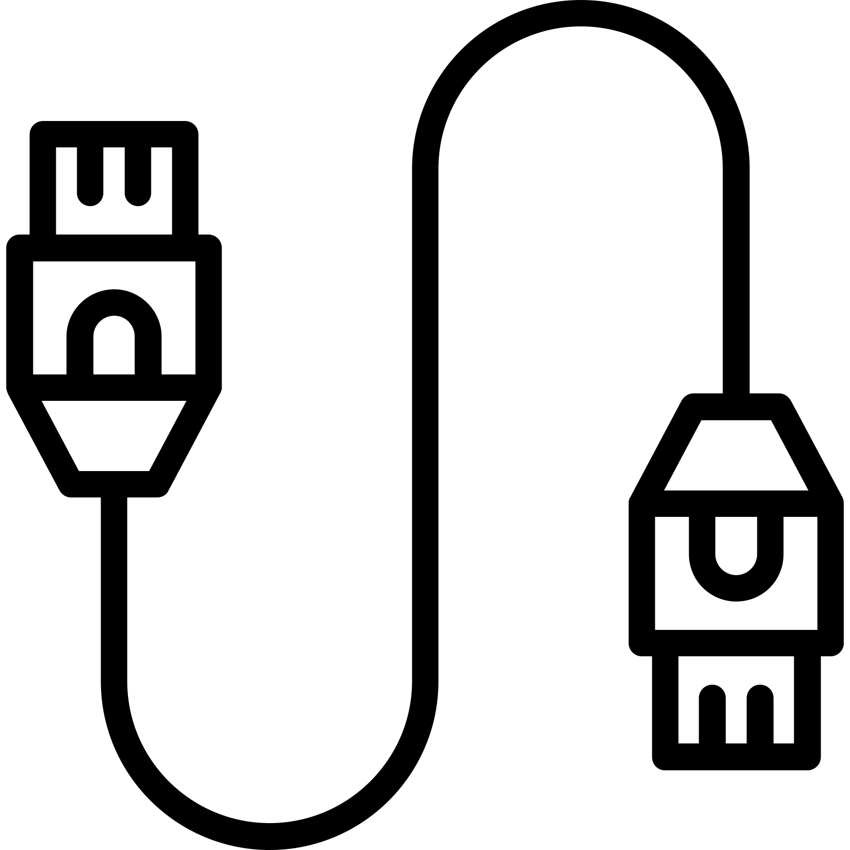
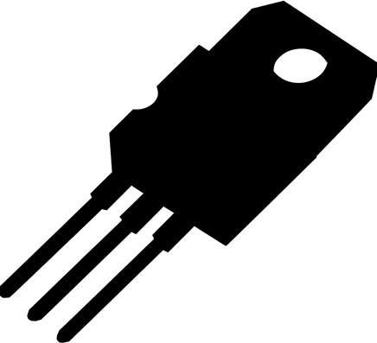
COMPONENTS & ARCHITECTURE
WORKER WRISTBAND
RP2040 SHRIKE LITE
Reads DHT11 and LDR every 2 seconds
Calculates Heat Index using temperature and humidity
Checks RFID registration status
Triggers alerts based on thresholds
Powered by a 9V battery
Components Overview:
DHT11: Measures temperature and humidity.
LDR: Detects sunlight.
Buzzer: Alerts workers.
⟶
SUPERVISOR STATION
WHY HEAT INDEX?
38°C at 90% humidity = Feels like 51°C = FATAL
38°C at 30% humidity = Feels like 37°C = SAFE
A basic thermometer cannot tell the difference.
Our device can.
RFID RC522 — Worker registration
Red/Green LED — Status indicator
Buzzer + Serial monitor — Alert output

Slide 5
RESULTS & FUTURE SCOPE
LIMITATIONS
WHAT THE DEMO SHOWS
DHT11 accuracy ±2°C — acceptable, makes alerts conservative
Worker taps RFID — system registers, monitoring starts
Currently wired between wristband and supervisor station
DHT11 + LDR feeds live data to serial monitor every 2 seconds
Pulse sensor dropped — unreliable on moving wrist
Heat Index calculated in real time from both readings
FUTURE SCOPE
ESP32 WiFi — wireless multi-worker real-time monitoring
Threshold crossed — buzzer fires, red LED triggers
Pulse sensor (finger clip) for heart rate confirmation
Conditions safe — green LED, system auto-resets
Mobile dashboard for supervisors with data logging
Source: IMD Heatwave Forecast April-June 2026 | Maharashtra worker deaths, April 2026 | US NWS Heat Index Formula

